Slide 1
CHEMISTRY-I
ELECTROCHEMISTRY
Mrinal Kanti Roy
Lecturer (Chemistry)
Mymensingh Engineering College

Slide 2
CONTENT
Electrolytes, Electrolysis,& Electrolytic cell
Faraday’s Law
Electrochemical cell
Standard Electrode Potential
Electromotive Force ( EMF)
Nernst Equation

Slide 3
ELECTROLYTES
Electrolytes are electrovalent substances that form ions in solution which conduct an electric current.
Example: Sodium chloride, copper (II) sulphate and potassium nitrate.
ELECTROLYSIS
The phenomenon of decomposition of an electrolyte by passing electric current through its solution is called Electrolysis (lyo = breaking).
ELECTROLYTIC CELL
The process of electrolysis is carried in an apparatus called the Electrolytic cell.

Slide 4
ELECTRODE
Two electrodes are needed to construct a electrochemical cell.
(i) Anode & (ii) Cathode
In anode; (1) Oxidation reaction occurred. (2) Electrons of anion of solution transfer to metallic rod (Anode)
In cathode; (1) Reduction reaction occurred. (2) Cations of solution accept electrons of metallic rod (Cathode).

Slide 5
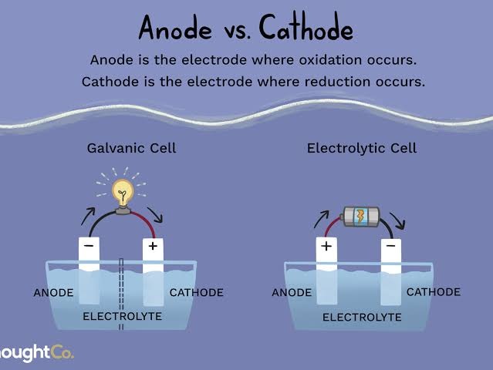
Fig-

Slide 6
FARADAY’S LAWS OF ELECTROLYSIS
First Law
The amount of a given product liberated at an electrode during electrolysis is directly proportional to the quantity of electricity which passes through the electrolyte solution.
Second Law
When the same quantity of electricity passes through solutions of different electrolytes, the amounts of the substances liberated at the electrodes are directly proportional to their chemical equivalents.

Slide 7
Definition of Electrochemical equivalent in light of First Law
If m is the mass of substance (in grams) deposited on electrode by passing Q coulombs of electricity, then m ∝ Q (First Law)
We know that Q = I × t
where I is the strength of current in amperes and t is the time in second for which the current has been passed.
Therefore, m ∝ I × t
or m = Z × I × t
where Z is the constant known as the Electrochemical equivalent of the substance (electrolyte).
If I = 1 ampere and t = 1 second, then m = Z
Thus, the electrochemical equivalent is the amount of a substance deposited by 1 ampere current passing for 1 second (i.e., one coulomb).

Slide 8
STRONG AND WEAK ELECTROLYTES
Strong Electrolytes
(1) The strong acids e.g., HCl, H₂SO₄, HNO₃, HClO₄, HBr and HI.
(2) The strong bases e.g., NaOH, KOH, Ca (OH)₂, Mg (OH)₂, etc.
(3) The salts. Practically all salts (NaCl, KCl, etc) are strong electrolytes.
Weak Electrolytes
(1) The weak acids : All organic acids such as acetic acid, oxalic acid,H₂SO_{3.}
(2) The weak bases : Most organic bases e.g., alkyl amines (C₂H₅NH₂)
(3) Salts. A few salts such as mercury (II) chloride and lead (II) acetate

Slide 9
ELECTROCHEMICAL CELL
A device for producing an electrical current from a chemical reaction (redox reaction) is called an electrochemical cell.
Voltaic Cells
A Voltaic cell, also known as a galvanic cell is one in which electrical current is generated by a spontaneous redox reaction. A simple voltaic cell is shown in Fig. Here the spontaneous reaction of zinc metal with an aqueous solution of copper sulphate is used. Copper rod is dipped in copper sulphate solution as cathode in a container; in another container zinc rod is dipped in zinc sulphate solution as anode. A U shaped tube full of inert electrolyte (KCl) solution is dipped into the two solutions to make contact with the solutions of the containers. Now, if the two electrodes are connected with wire the following oxidation-reduction.

Slide 10
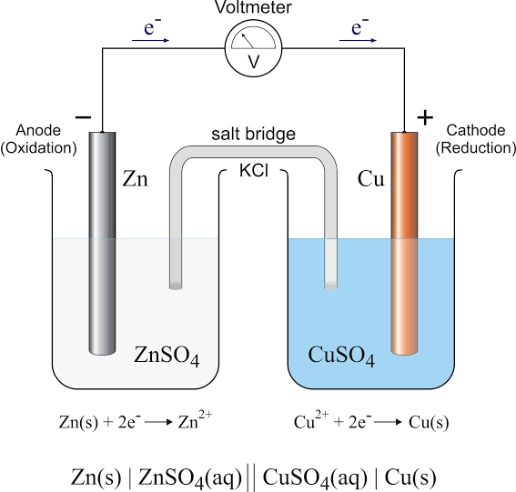
Fig-

Slide 11
FUNCTION OF SALT BRIDGE
1.Permits the passage of electric current internally.
2.Maintain the electric neutrality of the solution.
3.Prevents intermixing of the solutions.
4.It does not take part in cell reaction.

Slide 12
Electrode Potential
A potential difference develops between the electrode and the electrolyte which is called electrode potential.
Standard electrode potential When the concentrations of all the species involved in a half-cell is unity (concentration is 1M ) and temperature is 298 K, the electrode potential is known as standard electrode potential.

Slide 13
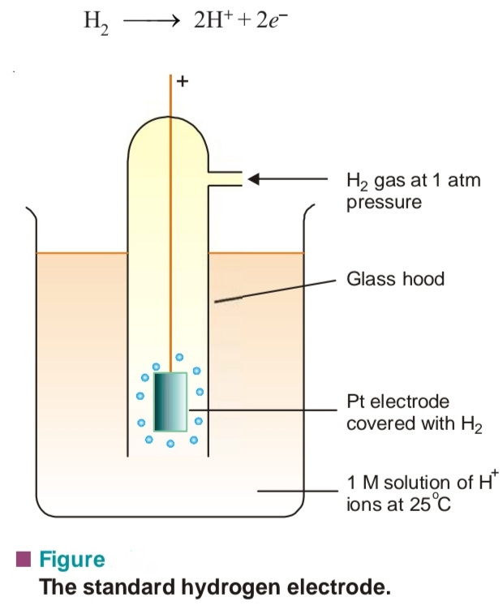
Fig: The standard hydrogen electrode

Slide 14
Electromotive force of cell or cell voltage
The difference in the electrode potentials of the two electrodes of the cell is termed as electromotive force[EMF] or cell voltage.
E_{cell} = E_{red} (cathode ) – E_{red} (anode)
or E_{cell} = E_{oxi}.(anode) – E_{oxi}.(Cathode)
or E_{cell} = E_{oxi}.(anode) + E_{red}(cathode)

Slide 15
Problem Predict whether the following reaction can occur under standard conditions or not.
Sn²⁺ (aq) + Br₂(l) → Sn⁴⁺ (aq) + 2Br–(aq)
Given E°Sn⁴⁺/Sn²⁺ = + 0.15, E°Br₂/Br– = 1.06V.
S o l :E_{cell} = E _{(cathode)} – E _{(anode)}
= 1.06 – 0.15
= 0.91V
_{cell}comes out be positive, this means that the reaction can occur..

Slide 16
